Slide 1

Handwriting Recognition
Jotiba Yadav (61)
Venkatesh Ganeshan (56)
Rushikesh Darge (08)
Project Guide
Prof. A. D. Palsodkar

Slide 2
Introduction
Handwriting recognition becomes increasingly important in the modern world due to its practical applications in our daily life. In recent years, numerous recognition systems have been introduced within many applications where high classification efficiency is required.
It helps us to solve more complex problems and makes ease our tasks.

Slide 3
Abstract
In a computer vision system, handwriting recognition is a complex task that is central to a variety of emerging applications. It has been widely used by machine learning and computer vision researchers for implementing practical applications like computerized bank check numbers reading.

Slide 4
Research Table
Title | Name | Year | Description
An Overview of Handwriting Recognition. | Homayoon Beigi Recognition Technologies, Inc. | 1997 | This paper is aimed at clarifying the role of handwriting recognition in accordance with today's maturing technologies. It tries to list and clarify the components that build handwriting recognition and related technologies such as OCR and Signature Verification.
Handwritten Digit Recognition Based on Depth Neural Network | Yawei Hou Huailin Zhao | 2018 | Neural network and depth learning have been widely used in the field of image processing. In order to obtain a higher recognition rate with a simple model, the BP neural network and the convolutional neural on the MNIST data set. the optimal result is 99.55%.

Slide 5
Artificial Neural Network
An ANN is based on a collection of connected units or nodes called artificial neurons, which loosely model the neurons in a biological brain. Each connection, like the synapses in a biological brain, can transmit a signal to other neurons. An artificial neuron that receives a signal then processes it and can signal neurons connected to it.

Slide 6
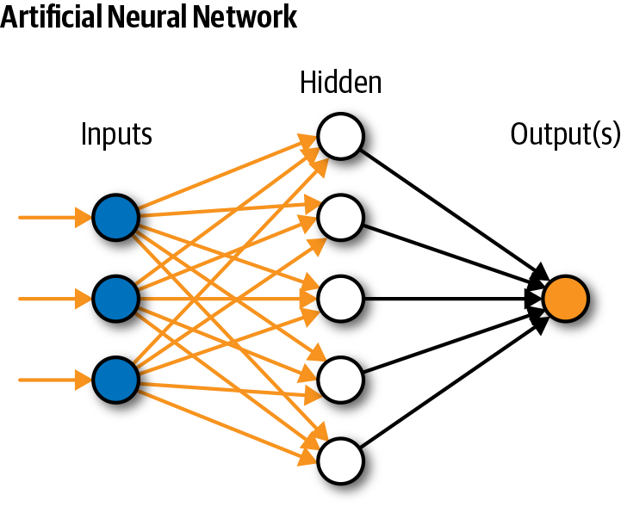

Slide 7
Approach using CNN
In Convolution Neural Network ,the convolution / fully connected layers perform transformations that are a function of the activations in the input volume
=> Why CNN
CNN learn faster
It has high computational efficiency (needs fewer operations to be able to learn)

Slide 8
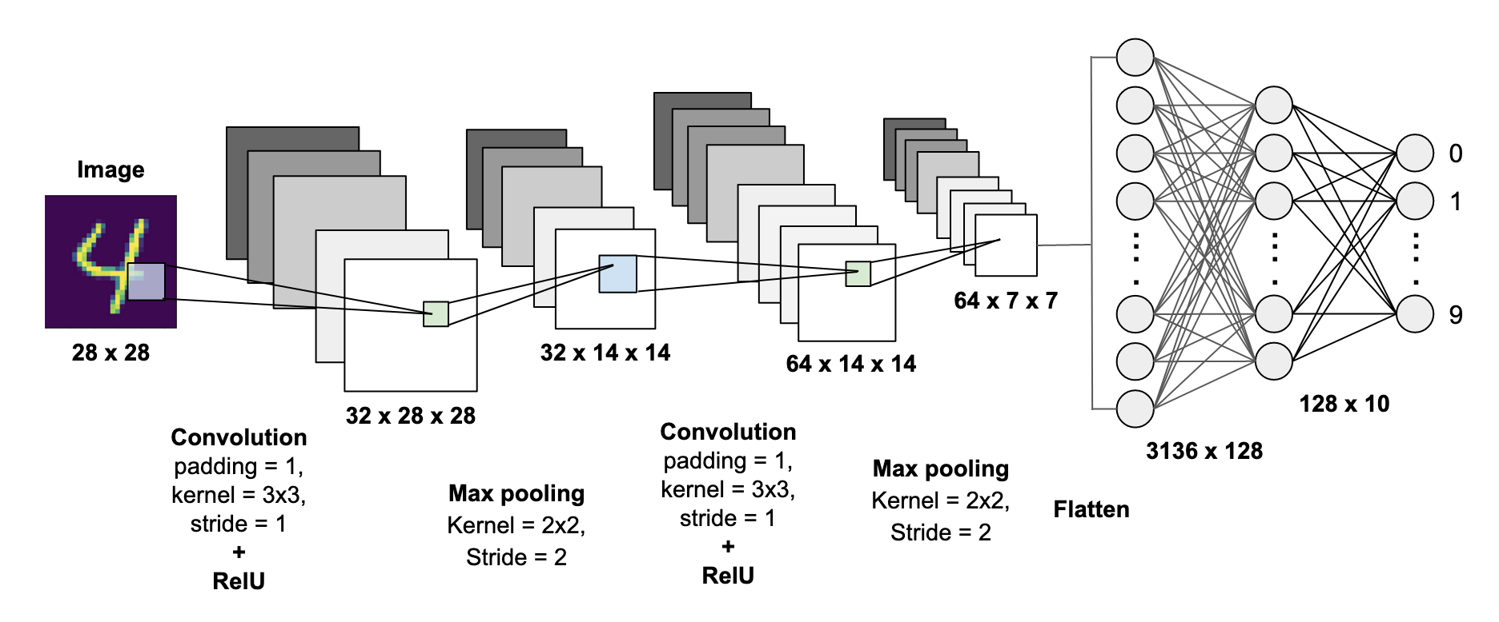
CNN

Slide 9
Approach using Bi-LSTM
LSTM in its core, preserves information from inputs that has already passed through it using the hidden state.
Use
Time series prediction
Speech recognition
Rhythm learning
Music composition
Grammar learning
Handwriting recognition

Slide 10

LSTM

Slide 11
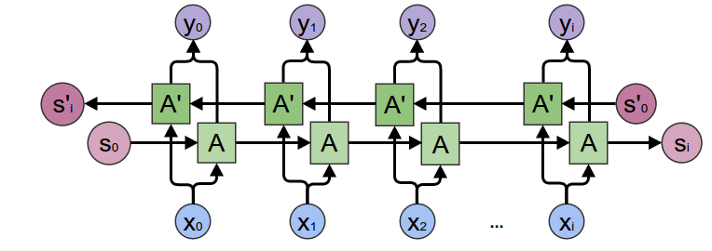
Bi-LSTM

Slide 12
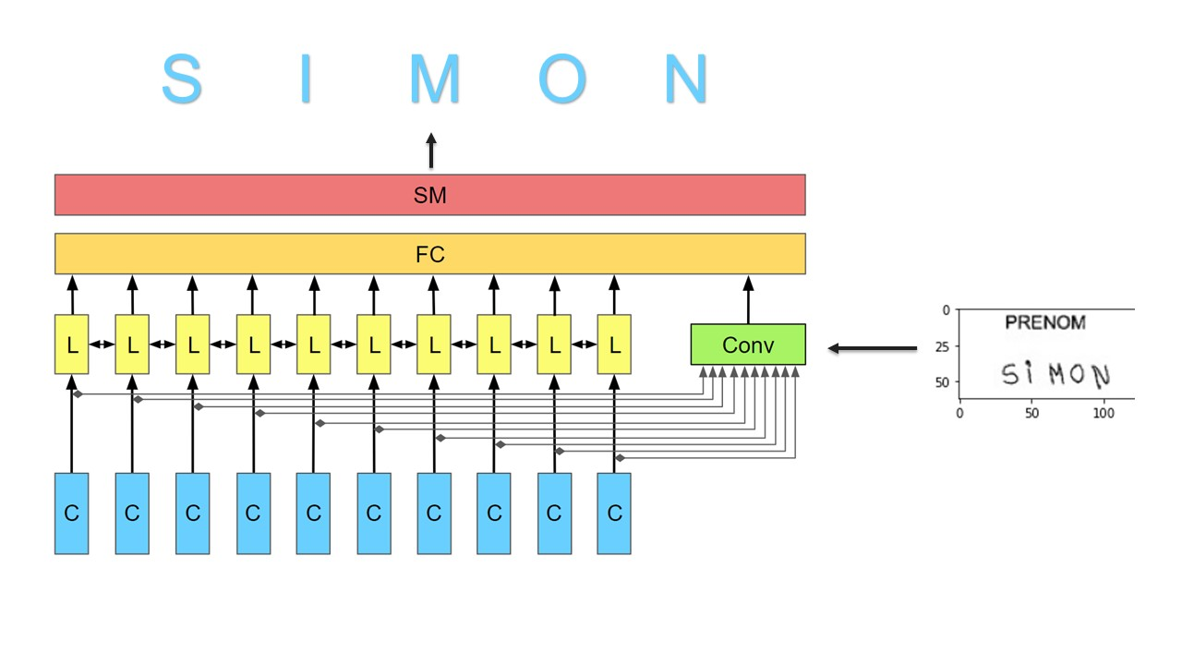
Model Architecture

Slide 13
Dataset
This dataset consists of more than four hundred thousand handwritten names collected through charity projects.
There are 206,799 first names and 207,024 surnames in total. The data was divided into a training set (331,059), testing set (41,382), and validation set (41,382) respectively.

Slide 14


Datasets

Slide 15

DEPLOYMENT
Streamlit : is an open-source Python library that makes it easy to build beautiful apps for machine learning. You can easily install it via pip in your terminal and then start writing your web app in Python. No require to any code of HTML & CSS.

Slide 16
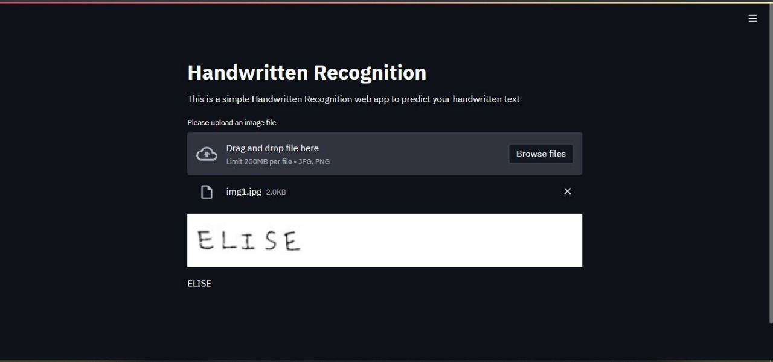
Output

Slide 17
Summary
Here we demonstrate a model which can recognize handwriting. Later it can be extended real-time person’s handwriting and many use case. Handwriting recognition is the first step to the vast field of Artificial Intelligence and computer Vision. There can be so much to explore in the World of AI.

Slide 18
Thank You !!!

